Slide 1
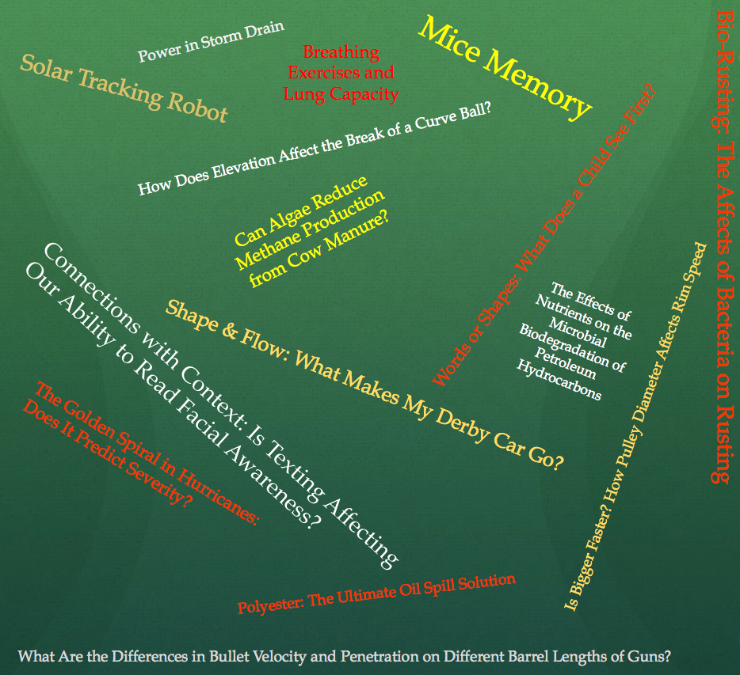
The Evolution of a Topic
Fog
Sunlight
Which Color Light Shines Through Fog Best?
Climate
How Does the Angle of Sun Rays Affect Temperature?
Something w/ Water

Slide 2
The Evolution of a Topic
Climate
How Does the Angle of Sun Rays Affect Temperature?
Does the Angle of a Light Source Affect Temperature?
Sunlight
Can Temperature be Predicted Using The Angle of Sunrays?
How Does the Inclination of a Light Source Affect Temperature & Can that be used to Predict Afternoon Temperatures?
Light
What is the relationship to Temperature & the Sun’s Location in the Sky?
How Does Light Inclination Affect the Amount of Heat Received from a Heat Source?

Slide 3
How Does Light Inclination Affect the Amount of Heat Received from a Heat Source?

Slide 4
How Does Light Inclination Affect the Amount of Heat Received from a Heat Source?
Light= Sun Rays
Inclination= Angle of Sun’s affect on Earth
Heat= Heat, Temperature, Thermal

Slide 5
Step 1
Quickly look at your research and highlight and write down possible subtopics

Slide 6
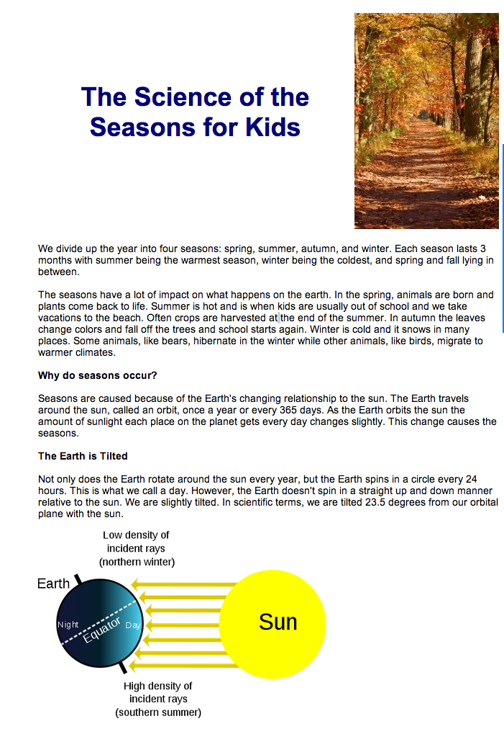
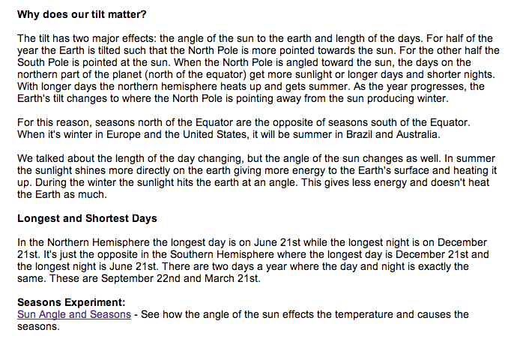
Possible Subtopics

Slide 7
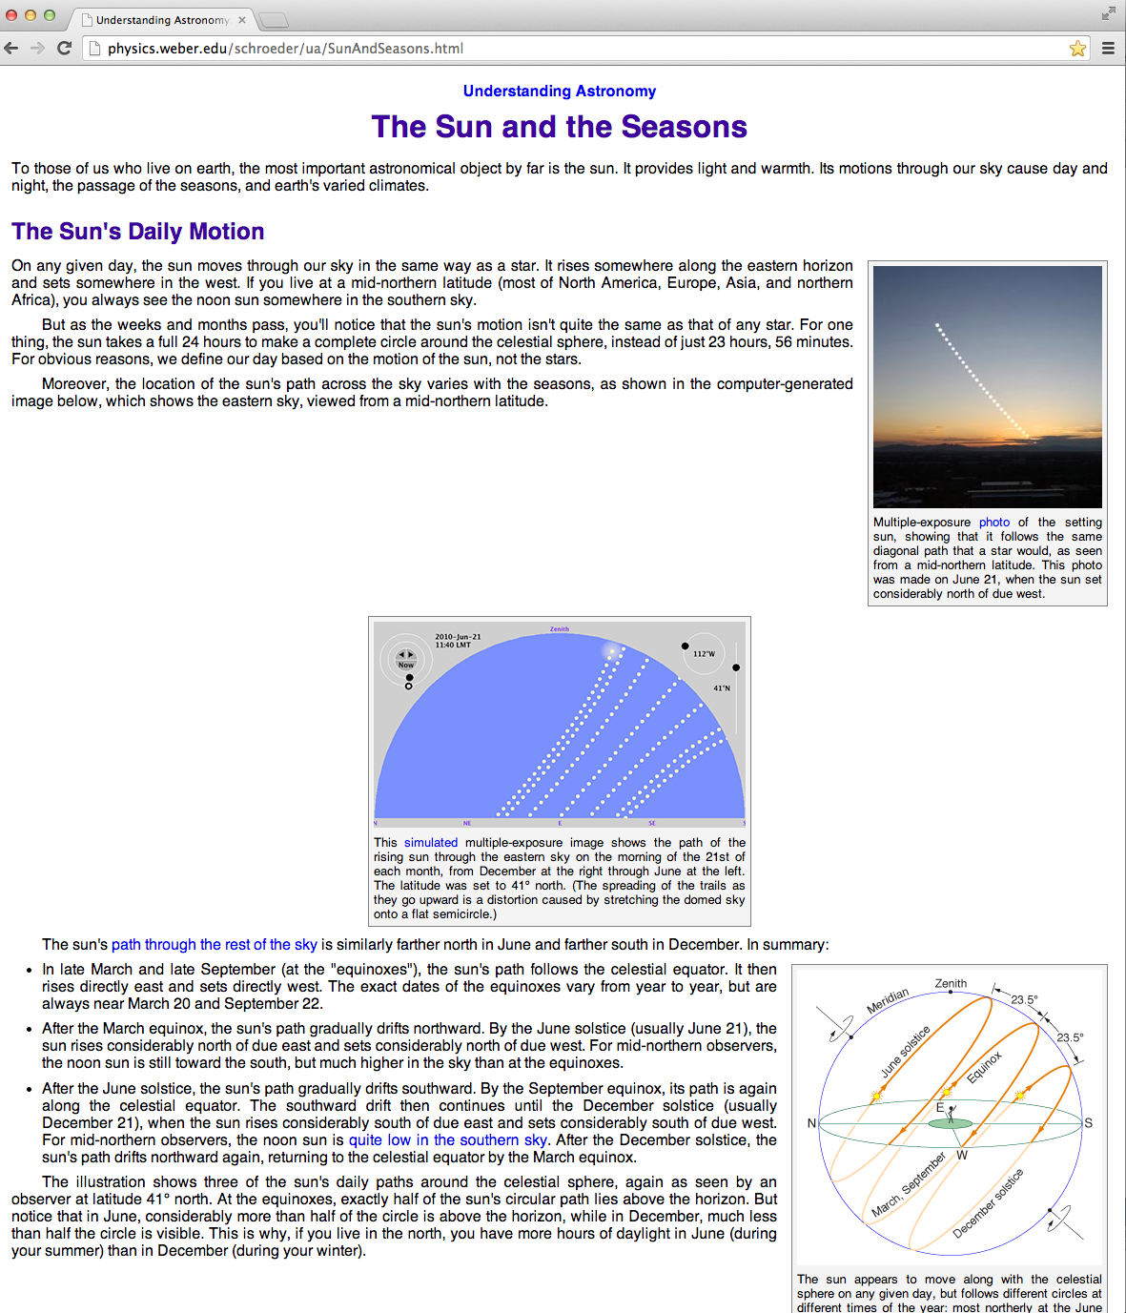
Possible Subtopics

Slide 8
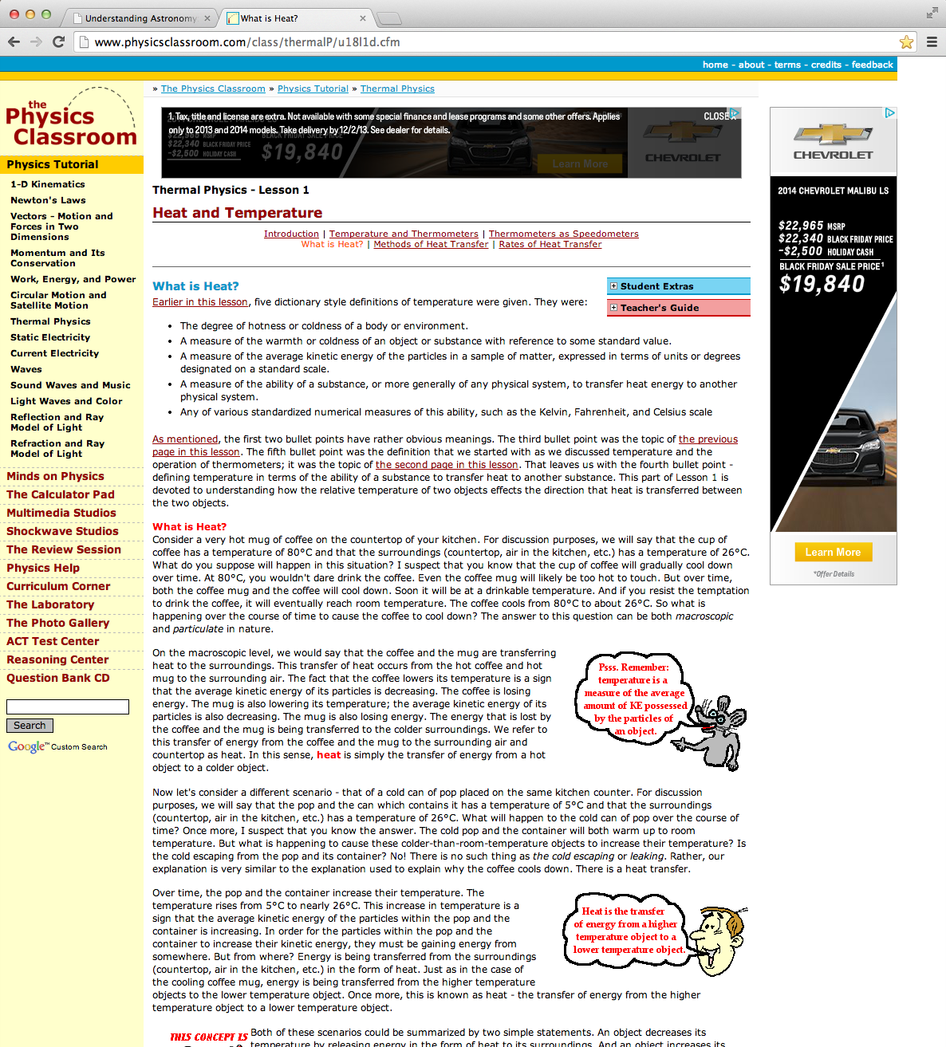
Possible Subtopics

Slide 9
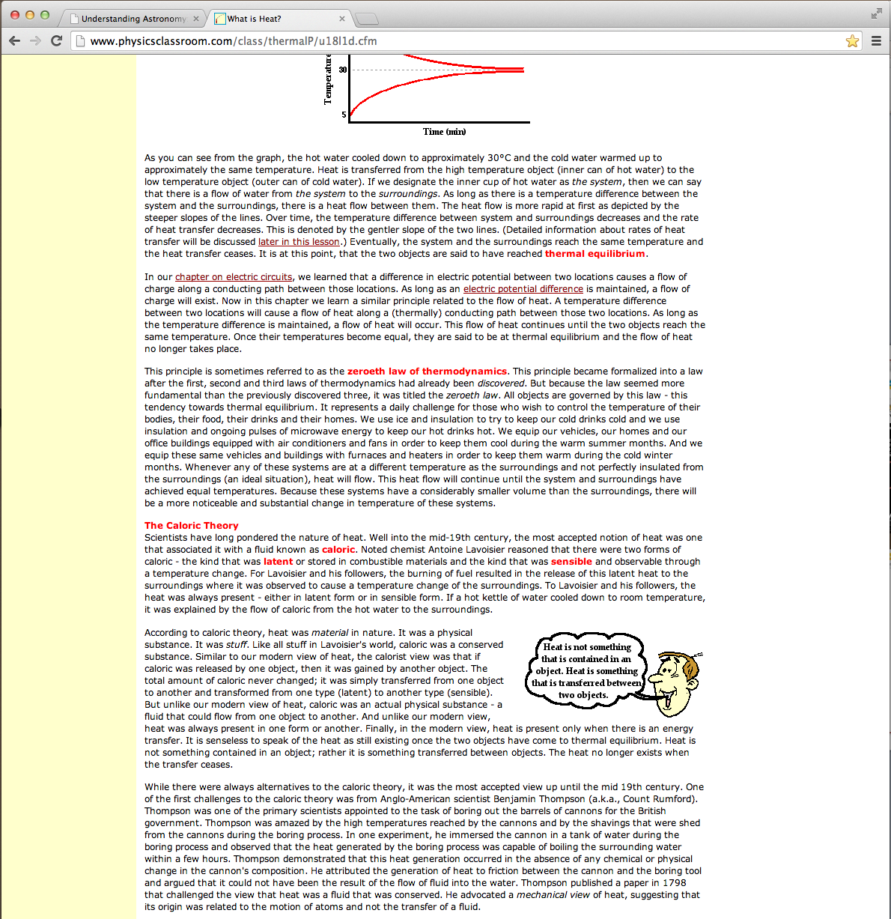
Possible Subtopics

Slide 10
Possible Sub Topics (Possible Title: How Does Light Inclination Affect the Amount of Heat Received fro a Heat Source?)
Heat Energy
Sun Rays
Seasons
Sun’s Daily Motion (?)
Why Do Seasons Occur
Temperature
What is Heat?
Law of Thermodynamics
Thermal Equilibrium

Slide 11
Step 2
Now, speed read and highlight key information for each of your subtopics

Slide 12
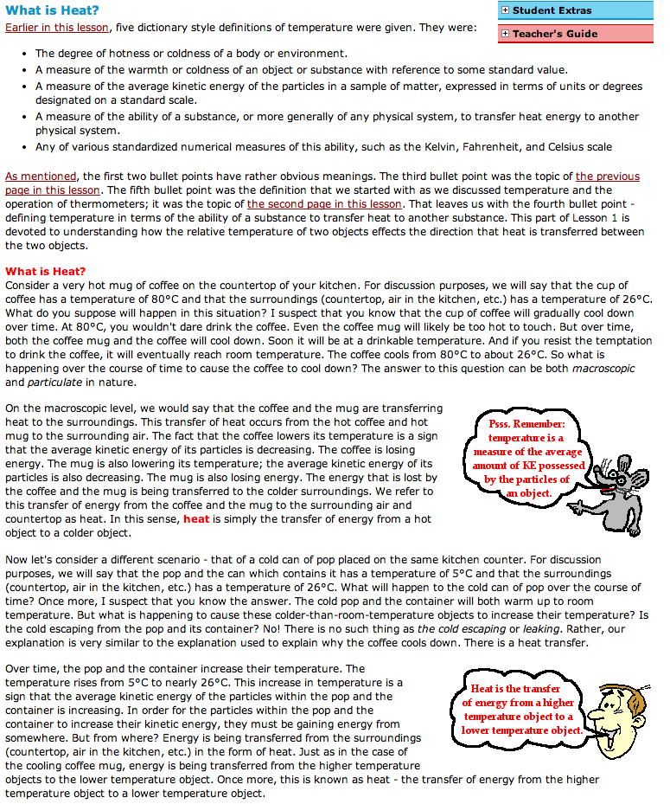
Only highlighting key information that has to do with my subtopic (Heat)

Slide 13
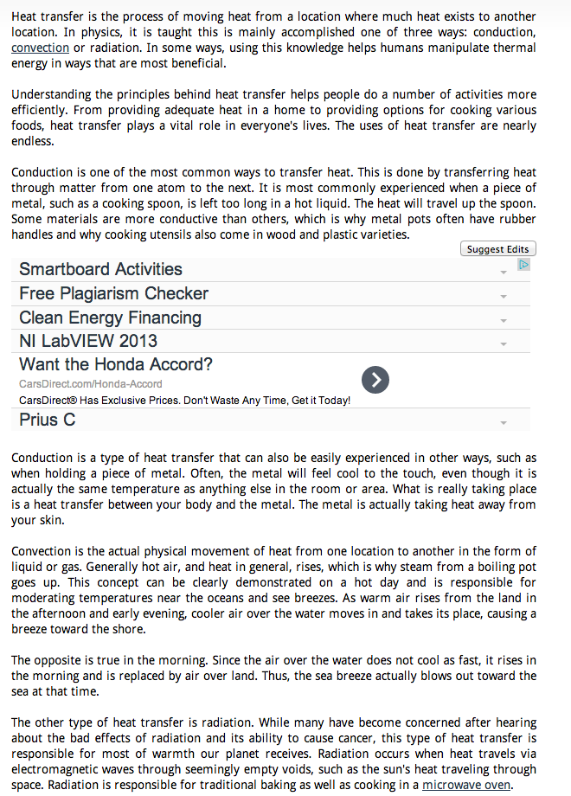
Still highlighting key information related to HEAT

Slide 14
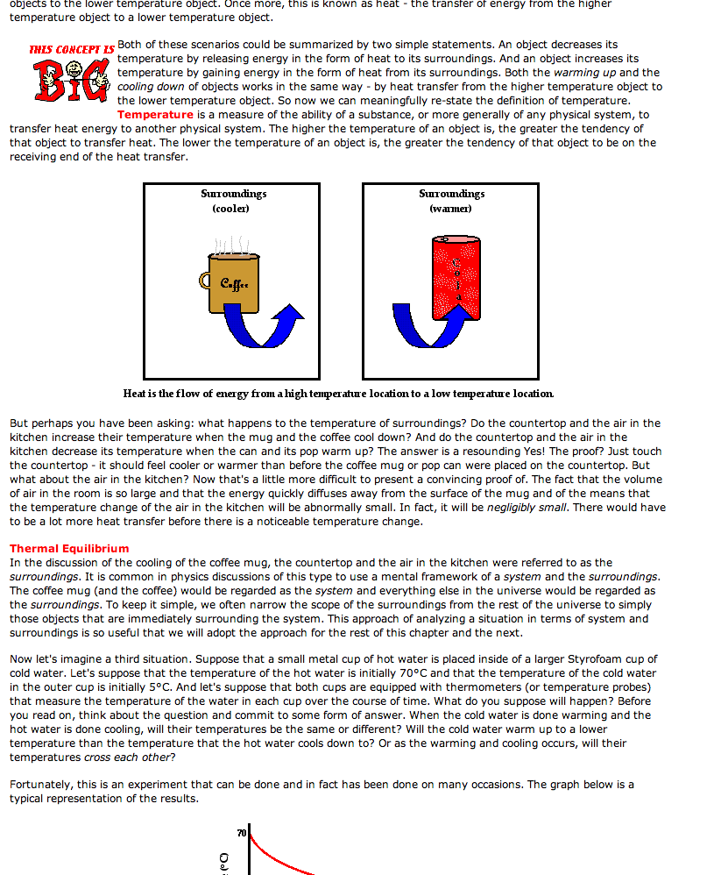
Now I’m highlighting key information about TEMPERATURE

Slide 15
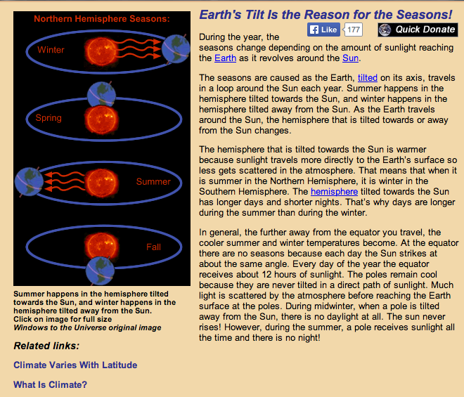
New Subtopic: Why Do Seasons Occur?

Slide 16
Step 3
Once you have highlighted key information for a subtopic, rewrite and copy that information in list format. Have a separate section for each subtopic

Slide 17
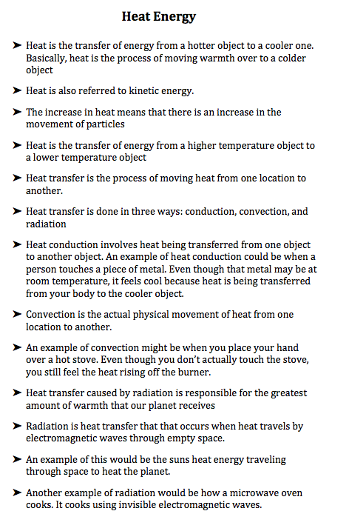

Slide 20
